Slide 1

tempAPP project
DESIGNING AN APPLICATION
FOR RASPBERRY-PI
TEMPERATURE AND
HUMIDITY MEASUREMENT
AND VISUALIZATION IN A
TOUCH SCREEN
by Ovidiu Mircea Moldovan

Slide 2
M
Makers & IoT
Problem & solution
Display I
Display II
RaspberryPi & LEDs
Backend
Management script
Results
Hurdles
Demo
Conclusions
Questions
<número>

Slide 3
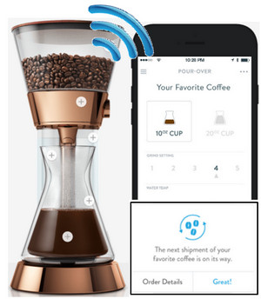
Makers & IoT
¿Did you know that by 2020 there will be 50G devices connected? (Network society)
There are many things to be implemented (Hw&Sw mix or different purpose technologies)
Today we may say this is a makers world.
Souerce: http://www.cepro.com/images/uploads/poppy_coffee_maker_300px.jpg
<número>

Slide 4
Problem & Solution
We had to build a temperature and humidity alarm system with a touchable display as an output.
System manager (C)
We had to build a temperature and humidity alarm system with a touchable display as an output.
Sensor controler lib (C)
Leds controler lib (C)
Management script (bash)
HIH-6120-021-001 sensor
4D uLCD-43PT
RaspberryPi + leds
<número>

Slide 5
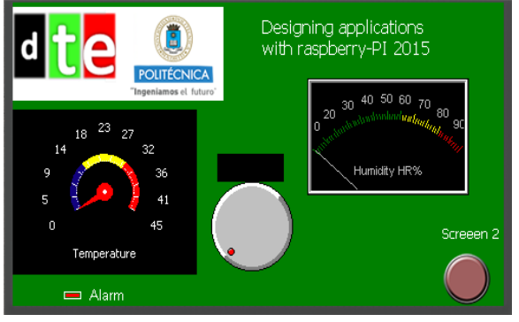
Display I
Image from department's web
All the others elements are the same as required
4D uLCD-43PT
<número>

Slide 6
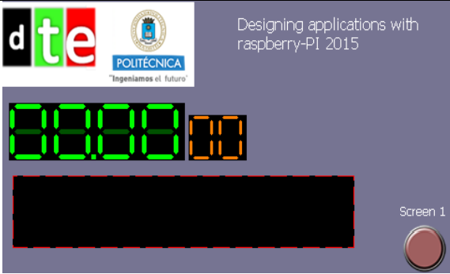
Display II
Image from department web
All the others elements are the same as required
4D uLCD-43PT
<número>

Slide 7
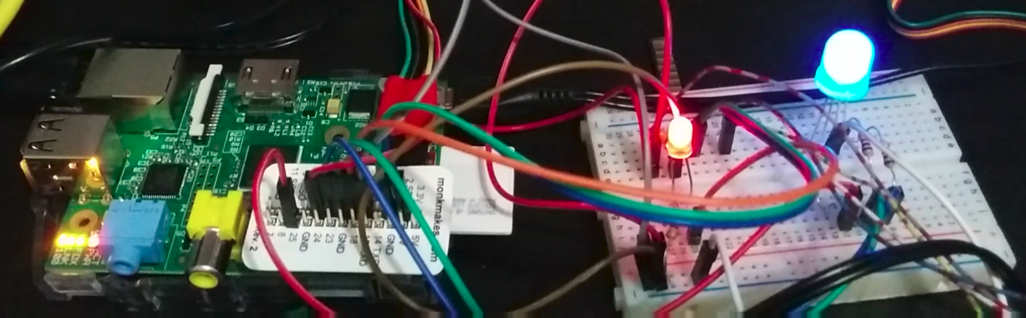
RaspberryPi and Leds
Builded in class (most of it)
HIH-6120-021-001 sensor
RaspberryPi + leds
<número>

Slide 8
Backend
C implementation
C main class as an orchestrator
build separate (as libraries) controllers:
for leds
for sensor
Used libraries(headers files)
Main file:
#include <pthread.h> \ #include <geniePi.h> //the ViSi-Genie-RaspPi library
Blinkie file: #include <wiringPi.h>
TempHum file: #include <linux/i2c.h> \ #include <linux/i2c-dev.h> \ #include <sys/ioctl.h>
System manager (C)
Sensor controler lib (C)
Leds controler lib (C)
<número>

Slide 9
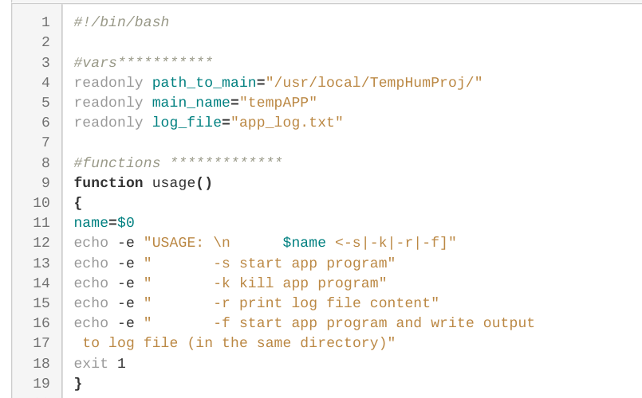
Management script
Bash implementation
Added to /etc/rc.local
Added to ->PATH=/usr/local/TempHumProj:"$PATH"
Use
Management script (bash)
<número>

Slide 10
Results
This tangle of wires and circuits...
<número>

Slide 11
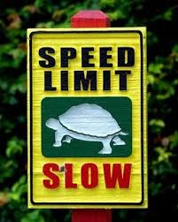
Hurdles
¿Where do you want me to start?
Latest Raspbian version (Jessie) has problems with serial connection
Old Raspbian (WHEEZY) has no preconfigurated i2c devices (we need) in config files
Corruptible SDs
The IDE (codeBlocks)
No time for more complains … live goes on
<número>

Slide 12
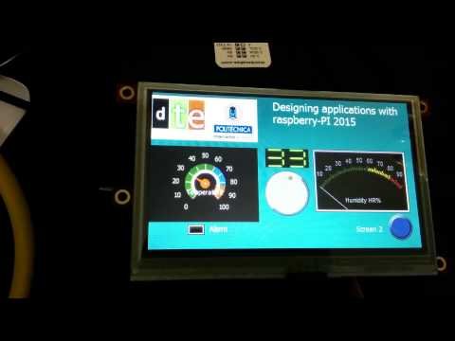
Demo time
<número>

Slide 13

Conclusions
More than 50% of the time spent on tasks not related with the project (learning the hard way they call it).
This was a great practice for IoT novices.
I have gladly renounced my sleep for it.
<número>

Slide 14

Questions please...
<número>

